Slide 1
Carrying out Investigations & Writing Lab Reports
Criterion C

Slide 2
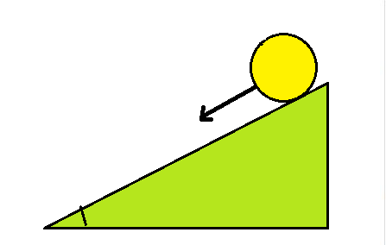
Criterion C – Results, Analysis, Conclusion and Evaluation
Criterion C is all about what information you can get from your results and how you can
evaluate and improve the method to account for limitations and uncertainties. It consists of 3 main
sections, some of which can be divided further into other sections or what the MYP calls “strands”.
Results: Divided into two sections
Strand (i) – Creating Results Tables and Graphs
Strand (ii) – Analysis and Interpreting the results
Conclusion: Strand (iii) – Answering the RQ,
discussing the hypothesis and giving an explanation.
Evaluation: Also divided into two sections
Strand (iv) – Evaluating the method
Strand (v) – Describing improvements
Note: As with any type of assessment, the most important thing is to do what is asked in the question. You may be asked to do some, all or none of the parts in each strand.
On the following slides, each section is described using an example. The results shown relate to an experiment which aims to investigate the relationship between the time taken and distance travelled for a ball rolling down a ramp.

Slide 3
Collecting Data
There are some important things to consider when collecting data during an investigation:
The IV must be changed at least 5 times
The IV should increase by the same amount each time ie. steady increments, eg. 2,4 6, 8 10 seconds or 5, 10, 15, 20 25 seconds, etc.
The DV should be measured three times for each value of IV, ie. 3 trials of data so that an average value of the DV can be calculated.
Note: Read the method section of the Criterion B PowerPoint on writing lab reports for more details on how to collect sufficient data.

Slide 4
Results - Table
Results from the investigation should be recorded in this section. Data should first be displayed in a table. The table should have headings which include units.
In this example Distance and Time data is recorded for a ball rolling down a ramp. The time was the IV so it was chosen that the time would be changed at intervals of 10 seconds and the Distance the object travelled would be recorded.
Note: If you did multiple trials, which you always should, you will need multiple columns for your DV and a column for the average value. One full row has been completed as an example.
Sample Results Table
Time / t (s) | Distance / D (m) |  |  | Average Distance / D (m)
 | Trial 1 | Trial 2 | Trial 3
10 | 32 | 34 | 30 | 32
Note that the headings in the column gives the physical quanitity being measured, the symbol that represents that quantity and the unit in brackets.
The IV should always be the first column and the DV should follow.

Slide 5
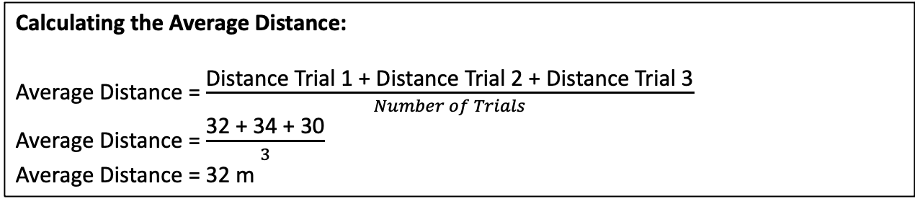
Results – Data Processing
Any calculations / data processing that was carried out on the recorded data should be clearly shown.
One example calculation should be included for any formula used or data processing used.
Note: This may not be required in an E-Assessment question if not asked for specifically, but it is good practice and is required in all lab reports at DP.
Example below – relating to the table from the previous slide.
Tip: It is a good idea if writing a report to include sample calculations in a text box for neatness with a heading for clarity.
Calculating the Average Distance:
Average Distance = $\frac{\text{Distance} \text{Trial}\text{ 1 + }\text{Distance} \text{Trial}\text{ 2 + }\text{Distance} \text{Trial}\text{ 3}}{Number of Trials}$
Average Distance = $\frac{\text{32 + 34 + 30}}{3}$
Average Distance = 32 m

Slide 6
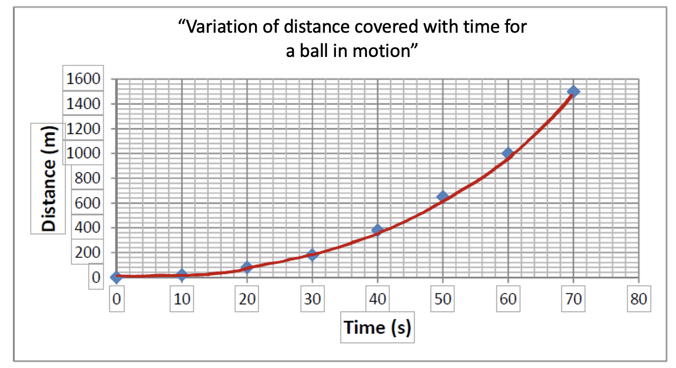
Results - Graph
Results should also be displayed in a suitable graph. This could be a bar graph (usually not in Physics) or line graph (most probably). You need to decide the correct type of graph based on your investigation. Continuous data is usually plotted on a line graph, whereas discontinuous data (involving groups or categories) is usually plotted on a bar graph or pie chart.
Your graph must include a title, axis labels and units for each axis label. For the title, the format should be “Variation of (insert y variable) with (insert x variable) for (give some detail or context about what was being investigated)”. For a line graph, it could be a straight line or a curve depending on the data. You need to look at the data (or associated formula) to decide the most suitable line of best fit.
Example: Distance/Time graph with title, axis labels and line of best fit showing the change in distance of a ball rolling down a ramp. The trend clearly indicates a curved line of best fit.

Slide 7
Interpreting the Results
How to describe the results:
Look at the results (ie. your graph) and describe any patterns shown in relation to your variables. As the independent variable increases, what happens to the dependent variable? Does it increase or decrease. How do you know – use data (ie. use specific numbers to justify your findings).
Comment on the type of relationship shown between the independent and dependent variables. What type of relationship is this? How do you know.
  If the y variable increases as the x variable increases the relationship is positive.
  If the y variable decreases as the x variable increases the relationship is negative.
  If the graph shows a straight line it is a linear relationship.
  If the graph shows a straight line which also passes through the origin it is a directly proportional relationship.
  If it is not a straight line or it does not pass through the origin then it is not directly proportional.
  Note: All proportional relationships are linear but not all linear relationships are proportional.
Describe any other information that you can interpret from the results, eg. what does the gradient of the graph tell you? We will practice this on a later slide.

Slide 8
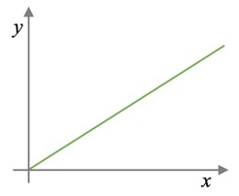
More on Proportionality
Note: This is one of the most fundamentally important ideas in Physics. There are two types of proportionality in Physics, Directly Proportional and Inversely Proportional.
Directly Proportional relationships
A directly proportional relationship is a type of positive relationship where both variables increase or decrease at the same rate, if you double one variable, you double the other, if you halve one variable you halve the other.
You can see it from the graph. If the line is a straight line and it passes through the origin (0,0), then y is directly proportional to x.
  You can also spot it from the formula. If the formula you are using is in the form y = k x, where y is a variable and x is a variable and k is a constant, then y is directly proportional to x.
  Example 1: From Newton’s 2nd Law: F = ma. Therefore, if the mass of the object is constant, then F is directly proportional to a.
  Example 2: E_{k} = ½ m v² , where E_{k} is kinetic energy. Again, if the mass of the object is constant (and since ½ is obviously a constant), the equation is in the form y = k x, where “y” is E_{k ,}
  “x” is v² and “k” is ½ m. Therefore, E_{k} is directly proportional to v².

Slide 9
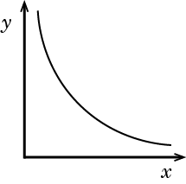
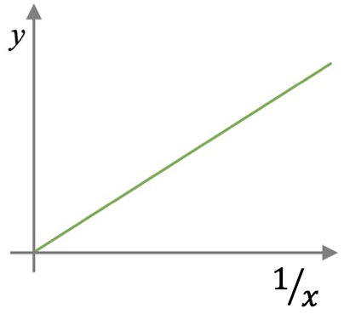
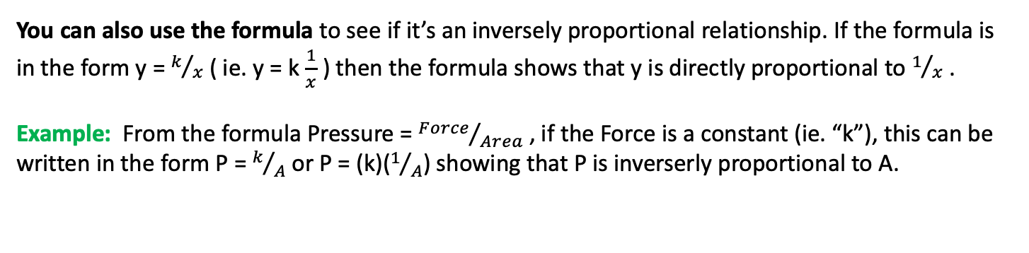
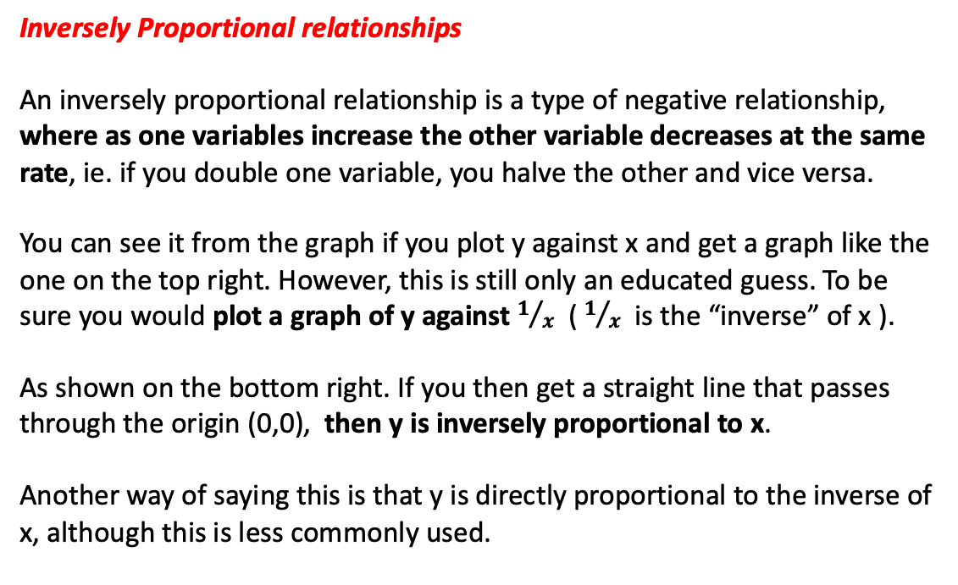
More on Proportionality
Inversely Proportional relationships
An inversely proportional relationship is a type of negative relationship, where as one variables increase the other variable decreases at the same rate, ie. if you double one variable, you halve the other and vice versa.
You can see it from the graph if you plot y against x and get a graph like the one on the top right. However, this is still only an educated guess. To be sure you would plot a graph of y against $1/x$ ($1/x$ is the “inverse” of x ).
As shown on the bottom right. If you then get a straight line that passes through the origin (0,0), then y is inversely proportional to x.
Another way of saying this is that y is directly proportional to the inverse of x, although this is less commonly used.
You can also use the formula to see if it’s an inversely proportional relationship. If the formula is in the form y = $k/x$ ( ie. y = k $\frac{1}{x}$ ) then the formula shows that y is directly proportional to $1/x$ .
Example: From the formula Pressure = ${Force}/{Area}$ , if the Force is a constant (ie. “k”), this can be written in the form P = $k/A$ or P = (k)($1/A$) showing that P is inverserly proportional to A.

Slide 10
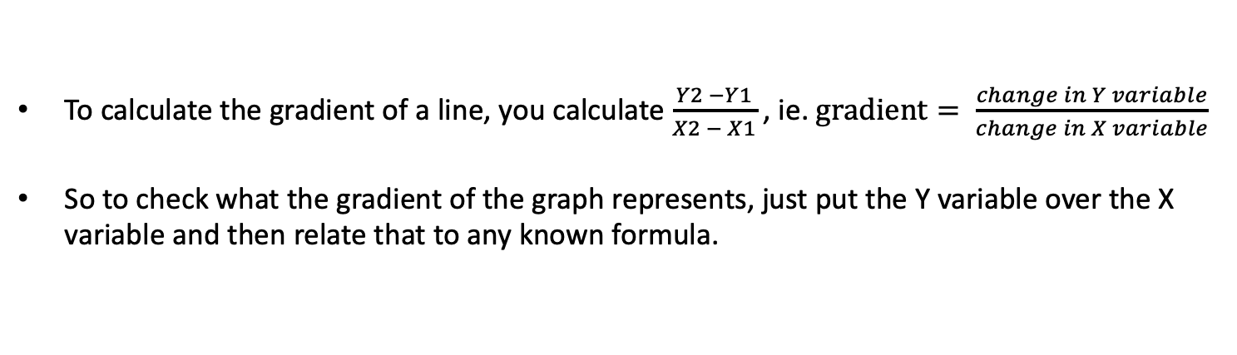
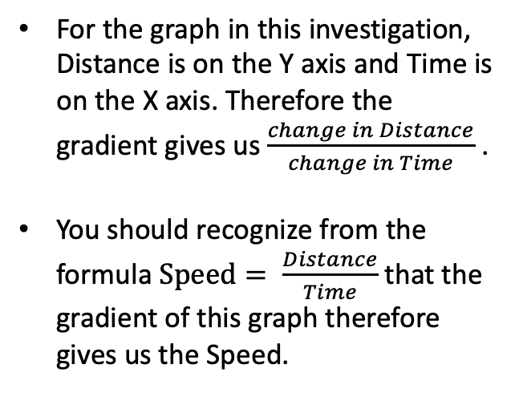
What is the gradient telling me?
To calculate the gradient of a line, you calculate $\frac{Y2 −Y1}{X2 − X1}$ , ie. $gradient= \frac{change in Y variable}{change in X variable}$
So to check what the gradient of the graph represents, just put the Y variable over the X variable and then relate that to any known formula.
For the graph in this investigation, Distance is on the Y axis and Time is on the X axis. Therefore the gradient gives us $\frac{change in Distance}{change in Time}$ .
You should recognize from the formula $Speed= \frac{Distance}{Time}$ that the gradient of this graph therefore gives us the Speed.
So whatever happens to the gradient, that’s what happens to the speed in this graph.
Remember the gradient just means how steep the line is, so if the line is getting steeper we would say the gradient is increasing, therefore that means the speed is increasing.

Slide 11
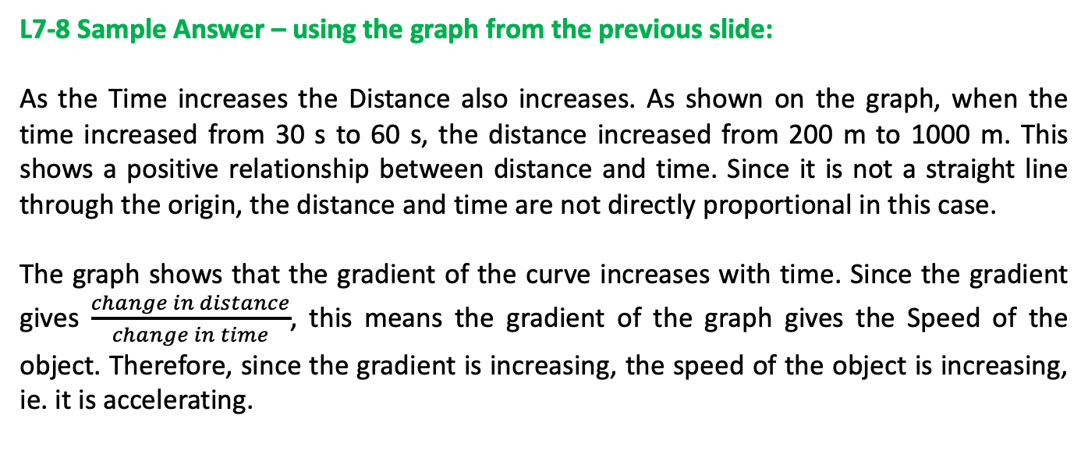
Interpreting the Results - Example
L7-8 Sample Answer – using the graph from the previous slide:
As the Time increases the Distance also increases. As shown on the graph, when the time increased from 30 s to 60 s, the distance increased from 200 m to 1000 m. This shows a positive relationship between distance and time. Since it is not a straight line through the origin, the distance and time are not directly proportional in this case.
The graph shows that the gradient of the curve increases with time. Since the gradient gives $\frac{change in distance}{change in time}$, this means the gradient of the graph gives the Speed of the object. Therefore, since the gradient is increasing, the speed of the object is increasing, ie. it is accelerating.

Slide 12
Further Analysis
Sometimes although the graph does not show a straight line, as with the graph in this experiment, it might suggest a relationship that could produce a straight line with some further calculation.
In this case, referring to the distance time graph for the ball rolling down the hill, the relationship between distance and time is not directly proportional, but this shape suggests that maybe the distance is directly proportional to the time squared (t²).
Taking the time for each of the distance values in the table and squaring it to calculate t² would allow you to plot a graph of Distance against (time)² as shown in the second graph on the right.
Note: You probably wouldn’t be expected to predict the relationship shown by the curve, but it might be suggested in the question to plot a graph of D vs t², or they might show you the completed graph of D against t² and ask you to interpret it.
See an example question and sample answer on the next slide.

Slide 13
Further Analysis – Higher Difficulty
Example Question:
The student hypothesized that the distance travelled by the ball rolling down the ramp was directly proportional to the square of the time.
The time values were all squared and a graph of d against t² was plotted as shown to the right. Analyze the graph to write a conclusion based on the student’s hypothesis.
L 7-8 Answer
Creating a graph of Distance against Time Squared produced a straight line through the origin. This shows that the Distance covered by the ball is directly proportional to the Time Squared. This means that the two variables increase at the same rate, ie. if the Time Squared is doubled from 2000 s² to 4000 s² then the distance also doubles from 480 m to 960 m. Therefore, the data supports the student’s hypothesis that the distance was directly proportional to the square of the time.
Note: Notice that the unit on the x axis has also changed from s to s². If the time values are squared, the units must also be squared. This is just something for you to be aware of. Make sure when quoting a value for t² that you use the unit s² and not s.

Slide 14
Finding the “Constant of Proportionality”
By creating a straight line graph, more information can be analyzed. Now that you have shown that there is a directly proportional relationship between distance and time squared for your moving ball you can calculate the constant of proportionality – this just means the gradient of a straight line!
Once you have the constant of proportionality, you can make an equation which would allow you to predict the distance covered for any given value of time. This is one of the most important and fundamental concepts in all of Physics because it is how we make new formulas.
This only works with straight lines, because they are in the form y = mx which is the equation of a straight line. Think about what this means. In the general equation for a line, y = mx, y is the y variable on your graph, ie. the distance in this case, and x is the x variable, ie. time sqaured in this case. The gradient “m” is your constant of proportionality which we call “k”. So the graph can be represented as a formula:
y = m x
ie.
Distance = (k) (Time Squared)
or
D = k t²
Since you calculated “k” by finding the gradient, you can fill in any value for t into the formula and it will tell you the distance travelled by the object.
Let’s try it. Go to the next slide.

Slide 15
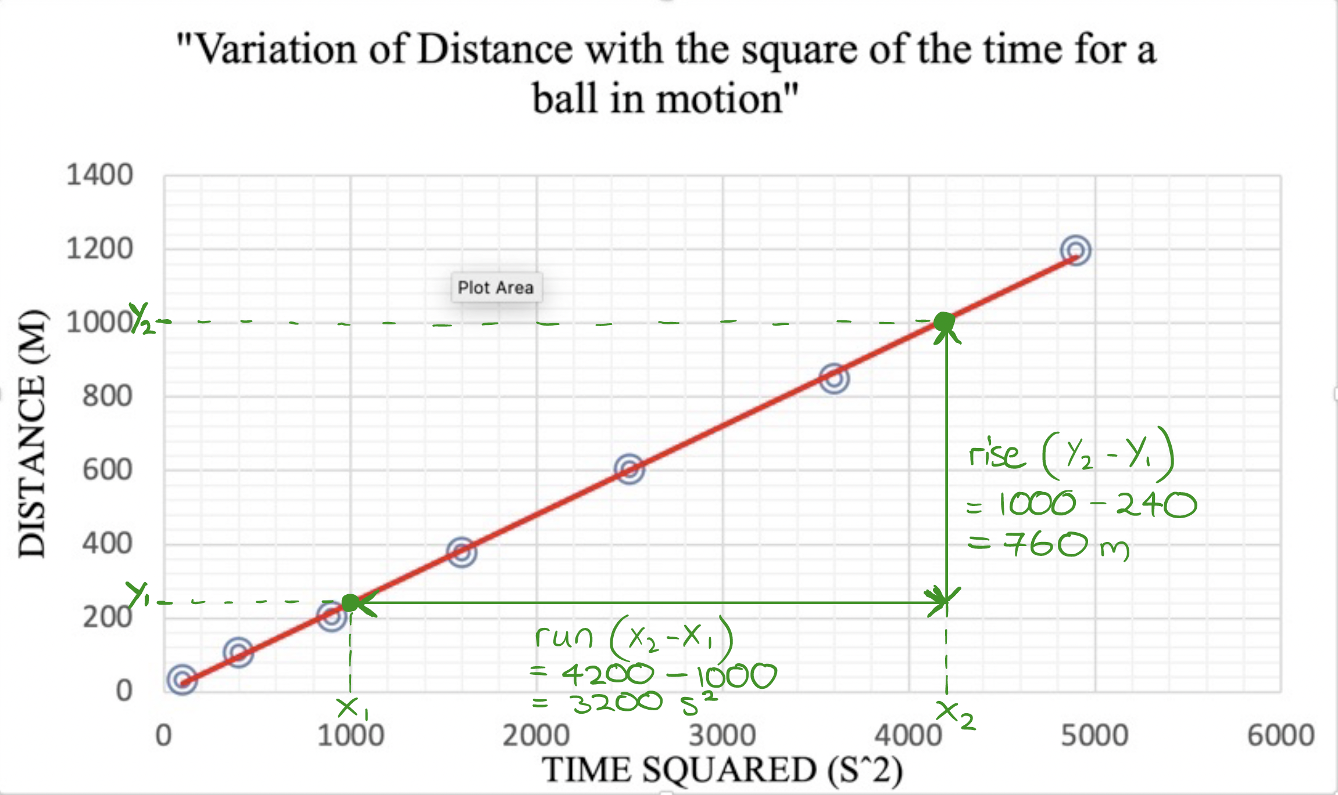
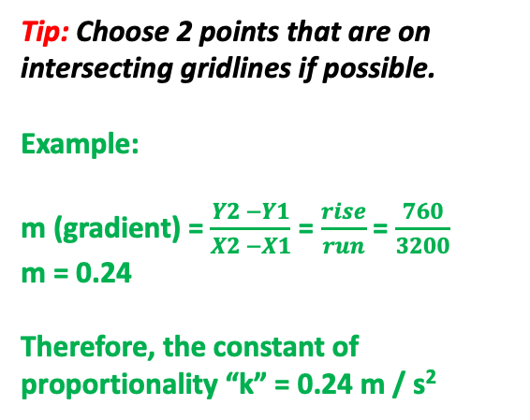
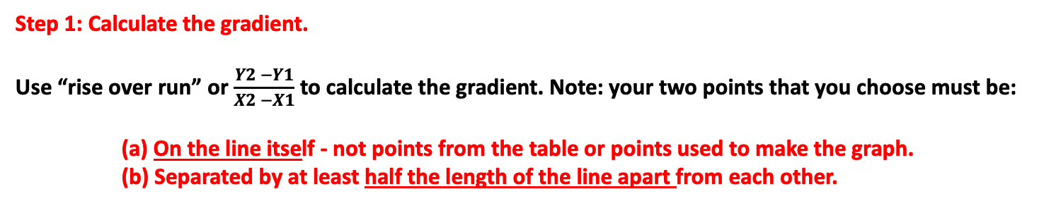
Finding the “Constant of Proportionality”
Step 1: Calculate the gradient.
Use “rise over run” or $\frac{Y2 −Y1}{X2 −X1}$ to calculate the gradient. Note: your two points that you choose must be:
(a) On the line itself - not points from the table or points used to make the graph.
(b) Separated by at least half the length of the line apart from each other.
Tip: Choose 2 points that are on intersecting gridlines if possible.
Example:
m (gradient) = $\frac{Y2 −Y1}{X2 −X1}$ = $\frac{rise}{run}$ = $\frac{760}{3200}$
m = 0.24
Therefore, the constant of proportionality “k” = 0.24 m / s²
Note: I found the unit for “k” by taking the unit of “Y” and dividing by the unit of “X”.

Slide 16
Using the constant of Proportionality
Step 2: Plug your K value into the formula that you have created using the graph.
D = K t²
Y = m X
therefore
D = 0.24 x t²
Note: From the previous slide k = 0.24 which is equal to “m”, the gradient of the line. Remember, k is our “constant of proportionality” which is the same thing as our gradient “m”, so we plug that into our formula that we made from the graph.
Sample Question: Find the distance covered by the ball after 150 seconds.
Sample Answer:
t = 150 s
and
D = 0.24 x t²
therefore
D = 0.24 x (150)²
so
D = 5400 m
Note: In some cases, you could take the time value you were given (150s), square it and then look at the graph to read the distance for that value of t² using the graph directly, but only if the line actually goes that far. In this case it does not go far enough (150² = 22,500 s² which is too big for this graph). So we need to use the formula.
Now you start to see the usefulness of the graph and the formula we created, because our Distance Time graph from earlier only went as far as 70 seconds (check back and see!), so reading the Distance for a Time of 150 s would be impossible. But with our formula that we made from the Distance vs Time Squared graph, we can calculate the distance for any time we want.

Slide 17
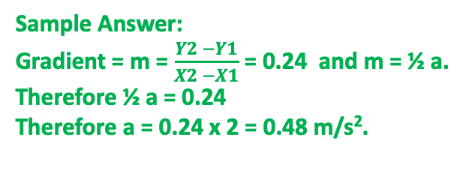
Another way to use the gradient
Note: You might be given a formula that you can relate to your graph, or you might have to relate the formula of the line to a known formula as we did with the distance time graph. For example, there is a formula that would apply to a ball rolling down a ramp. It’s comes from one of our “suvat” equations.
The formula relating to this investigation would be D = ½ a t² where a is the acceleration of the ball.
Look at how this relates to our equation D = K t² and the equation of a straight line, y = mx for our graph where y = D and x = t². See the comparison below.
y = m x
D = (K) t²……………. D is y, t² is x, so k is m.
D = (½ a) t² …………… The equations match, so k = ½ a = m
Look how similar they are. Can you see that comparing these two equations shows us that our constant of proportionality k = ½ a (ie. the gradient of the line, m = ½ a). So we can find “a” by using the gradient.
Sample Question: Given the formula D = ½ a t², use the graph to calculate the acceleration of the ball.
Sample Answer:
Gradient = m = $\frac{Y2 −Y1}{X2 −X1}$ = 0.24 and m = ½ a.
Therefore ½ a = 0.24
Therefore a = 0.24 x 2 = 0.48 m/s².
Note: Notice how when we calculated the gradient earlier we divided the rise over the run which was 760 m divided by 3200 s². The answer was 0.24 and the unit would be m/s², which is the unit of acceleration. Checking the unit of the gradient gives a clue about what it can be used to find.

Slide 18
Writing a Conclusion
Step 1: State and justify whether your results support the hypothesis or not or State and justify an answer to the Research Question. Use data form the experiment to justify your statement in either case.
Sample Question:
A student hypothesized that the distance travelled by the ball when falling down the ramp would be directly proportional to the time. Discuss whether the data provided supports the hypothesis.
Note: We will use the data collected and shown on the two graphs provided from the previous slides to write our conclusion based on this question.
Example Answer:
The hypothesis for this investigation was that the distance would be directly proportional to the time. Since the graph of distance vs time showed a curve, not a straight line, the data does not support this hypothesis. However the graph of distance against the square of the time showed a straight line through the origin showing that D ∝ t². Therefore as t² doubles, D will double.

Slide 19
Writing a Conclusion
Step 2: Include scientific reasoning to explain your conclusion.
Example Answer:
The graph shows that the speed of the object was increasing, ie. it was accelerating. This is shown by the data since the gradient of a distance time graph equals the speed and the gradient of this graph is increasing as time increases.
For an object to accelerate there must be an unbalanced force acting on it. In this case, the force due to gravity (ie. the object’s weight) is pulling it down the slope. This force must be bigger than the total resistive force experienced by the ball in the opposite direction (ie. friction + drag). This means it would have an unbalanced force down the slope which results in an acceleration in that direction.
However, if the velocity continues to increase, the drag force will also increase until the resistive forces (ie. the drag + friction) equal the force of gravity pulling the ball down the slope. At this point the speed would be constant since there would no longer be an unbalanced force acting on the ball. At this point the gradient of the distance time graph would be constant and the distance and time would increase proportionally from this point.
Note: You wouldn’t necessarily need to write all this to get the marks, but I’m trying to show the examiner as much “Physics” as I can so that he/she knows that I have a good understanding of the concepts (if I have some extra time at the end of the exam for example). That way, even if parts of my answer are not in the markscheme specifically, I may get the benefit of the doubt if the markscheme allows (ie. “OWTTE”).

Slide 20
Evaluation
This is the easiest part of any Criterion C and should be your best opportunity to pick up some marks, especially since the questions and answers are quite predictable.
There are 4 parts to an Evaluation:
  Discussing strengths
  Discussing limitations
  Suggesting and explaining improvements
  Suggesting extensions
First, look at the data on the graphs as well as the steps in the method to find strengths and limitations.
Note: You may be asked to simply state some strengths or limitations or to explain them. As always, do as asked in the question.

Slide 21
Evaluation
Identifying strengths and limitations from the method
Strenghts are anything in the method that improve the reliability of the investigation. Limitations reduce reliability. State the strength or limitation and explain the effec it had on the investigation if asked to explain. Here are some common examples of strenths in a method.
Strength | Explanation
Broad range of values for IV | Increases reliability of conclusions. Gives evidence for the relationship over a wider range.
Steady / regular increments of IV | Increaes reliability of conclusions. Gives better evidence of the observed trend. Pevents gaps in the data where confidence in the trend may not be justified.
Repeated trials for DV and average value calcualted | Reduces the effect of random error on the investigation Improves reliability of data Makes it easier to spot outliers.
CVs were kept constant (state specific examples) | Ensures that observed trend was caused by a change in the IV and not some other variable. Improves reliability of conclusions by inreasing confidence in the trend.
Note: You must check to see if these things were actually done before selecting them as strengths. If they were not done then they are limitations. Change the wording of the explanation slightly and you have your limitations.

Slide 22
Evaluation
Identify strenghts and limitations from the data
Sometimes the data suggests that there are strengths or limitations in how the experiment was conducted. Some examples are outlined below.
If all the data points lie directly on the line of best fit, this indicates high precision, decreased effect of randrom errors and increases confidence in the trend. If the points are scattered either side of the trend line, this indicates low precision, random errors have affectd the investiation and there is decreased confidence in the trend.
If you expect a relationship to be directly proportional and the graph does produce a straight line, but that line does not go through the origin, this would suggest a “zero erro” in one of your measured variables, ie. a systematic error caused by the fact that the measuring device was not zeroed before use. This reduces the reliability of your investigation by negatively affecting the accuracy of your measurements. All values will be off by the same amount.
Look for outliers or anomalies in the data. These are points on the graph or data measurements in the table that fall far outside the trend compared with other data points. This would indicate that something went wrong with this measurement, most probably a random error affected the measurement, or the device was not zeroed or calibrated correctly on this trial (systematic error). You would need to think of possible causes for this and look at the method for possible errors in how the measurement was taken.

Slide 23
Evaluation
Identify strenghts and limitations from the equipment
Sometimes the equipment used is not appropriate, it is not used correctly (affecting the accuracy) or the precision of the instrument is low. Some examples are outlined below.
Measurement devices which allow for small changes in variables improve the precision of that measurement (strength), ie. large nubmers of decimal places for digial devices or small increments on the scale of measurement for analogue devices. Eg. a ruler with increments of 1 mm is more precise than a ruler with increments to the nearst 0.5 cm. Another example would be using a measuring cyclinder instead of a beaker to measure volume.
If a measurement is taken on an unstable surface or the instrument is prone to random movement or changes, then this will increase the effect of random errors and reduce precision. Steps that are taken to prevent such effects can be seen as strengths, eg. clamping a ruler in place so that it cannot move, allowing water to settle in a measuring cylinder before measuring the volume etc.
Measurements not taken at eye level cause a specific type of error called “parallax error”. This means the value taken will not be the true value (ie. it is not accurate). If all measurements were taken from the same position, the parallax error will be the same for all measurements (ie. systematic error), buf if the position was different for each measurement (more likely) this would cause a different error for each measurement, thereby also affecting the precision (ie. random error).

Slide 24
Evaluation
Identify strenghts and limitations from the equipment - continued
If an instrument is not zeroed before use, all the measurements taken on that device will be off by the same amount, indicating a systematic error. This negatively affects the reliability of the investigation by reducing the accuracy of that measurement.
If a timer is used, human reaction time affects the accuracy of the time measurement. If the same person takes the time for each point then the error would be the same each time (approximately) indicating a systematic error. If different people take the measurement, the reaction time for each person would also differ and the error would be different each time, causing a random error and reducing precision.
Note: It is generally stated that random erors affect the reliability of an investigation by reducing precision while systematic errors reduce accuracy. Remember that precision relates to how close the values are to eachother within a set of trials, or how closely the data fits the trendline, but accuracy is how close the recorded value is to the true value. Be careful to use these words in the correct context, otherwise you may lose marks.
Systematic errors are errors that are the same for each value, ie. each value is off by the same amount. Random errors are errors that are different for each value and are usually caused by random fluctuations (changes) to environmental conditions like temperature, wind, shaky surfaces, etc.

Slide 25
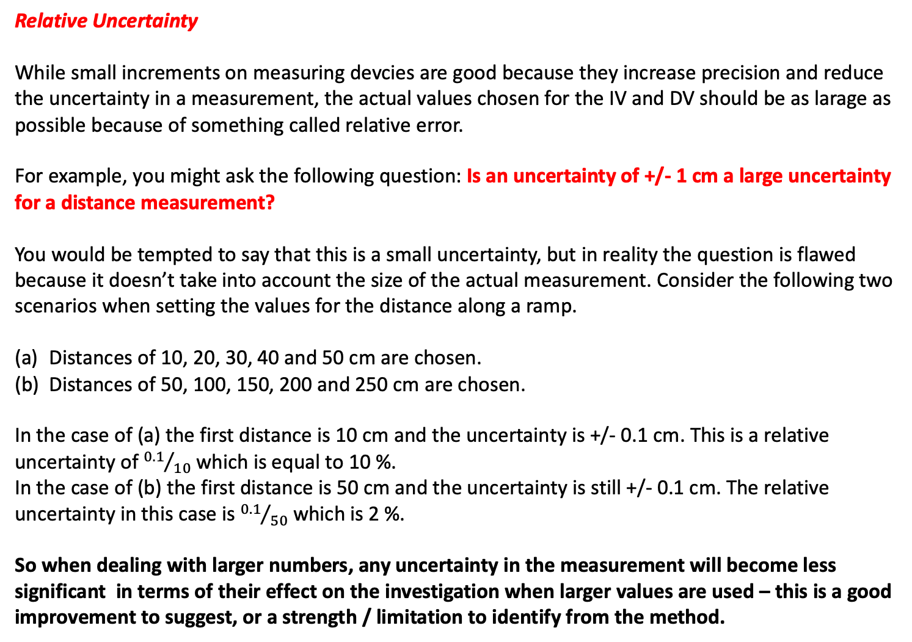
Evaluation
Relative Uncertainty
While small increments on measuring devcies are good because they increase precision and reduce the uncertainty in a measurement, the actual values chosen for the IV and DV should be as larage as possible because of something called relative error.
For example, you might ask the following question: Is an uncertainty of +/- 1 cm a large uncertainty for a distance measurement?
You would be tempted to say that this is a small uncertainty, but in reality the question is flawed because it doesn’t take into account the size of the actual measurement. Consider the following two scenarios when setting the values for the distance along a ramp.
Distances of 10, 20, 30, 40 and 50 cm are chosen.
Distances of 50, 100, 150, 200 and 250 cm are chosen.
In the case of (a) the first distance is 10 cm and the uncertainty is +/- 0.1 cm. This is a relative uncertainty of ${0.1}/{10}$ which is equal to 10 %.
In the case of (b) the first distance is 50 cm and the uncertainty is still +/- 0.1 cm. The relative uncertainty in this case is ${0.1}/{50}$ which is 2 %.
So when dealing with larger numbers, any uncertainty in the measurement will become less significant in terms of their effect on the investigation when larger values are used – this is a good improvement to suggest, or a strength / limitation to identify from the method.

Slide 26
Evaluation
Improvements
You need to describe improvements for each of the errors that you identified.
These should be specific, not vague comments like “increase the accuracy of the investigation”.
They should involve specific steps or equipment that could be used to improve the accuracy and/or precision of the measurements, how to reduce systematic or random errors and how to control your variables more reliably to increase the reliability of your conclusions.
Example 1: To improve the accuracy of the time measurement and reduce the systematic error caused by the reaction time of the person using the stopwatch, an automatic timer could be used. An example of an automatic timer would be a piece of equipment called a light gate which records the time at which an object passes through the gate.
Example 2: Increase the number of trials for the DV measurement and take an average. This would reduce the effect of random error on the DV measurement and increase reliability of these measurements.
Example 3: Use a broader range for the IV and increase the number of IV measurements. This would give more evidence to support the trend and improve the reliability of the conclusions.
Note: Look at the strengths identifed earlier, if they were done they are strengths, but if they were not done then you can identify limitations and suggest those things as improvements for the investigation.

Slide 27
Evaluation
Extensions
An extension to an investigation usually involves changing the IV in order to determine relationships for other factors that might affect the DV. You might make one of your CVs the new IV for your extension.
You could also choose a different DV to see what other factors are affected by changes to the original IV.
The extension should add value to the investigation and answer some questions that arose during the original investigation.

